Slide 1













Sponsors
Notes:
Can’t emphasise enough how much they make it happen.
Platinum Sponsors:
University of Leeds – Venue & support.
DevExpress – Teas & Coffees.
Black Marble – organisation, design etc.
Sage – speaker shirts & general platinum sponsor.
Sonoco Trident – general platinum sponsor.
NDC – general platinum - visit their stand!
Equal Experts – pre-DDD North dinner (speakers, helpers & friends)
Silver Sponsors
X-lab
Github
Bronze Sponsors
JetBrains – licenses!
O’Reilly – vouchers!
Huddle – agendas ☺
Microsoft Press – books & vouchers!

Slide 2
10 more things
Joel Hammond-Turner
@Rammesses
You need to do to succeed as a Tech lead

Slide 3
The Original 10 Things
1 – Have Coding Standards
2 – Have Process & Automation
3 – Use Personas
4 – Use Sketches
5 – NuGet all the things
6 – Handle Tech Debt
7 – Use MDDs & POCs
8 – Drive Sprint Planning
9 – Listen, Appraise & Decide
10 – Learn & Share Continually

Slide 4
Thing 1: …
New!
Break down your
Requirements

Slide 5
Thing 1: Break down your Requirements
New!
Implement Quick Search
Create Web App (inc build & deployment)
Search page (controller / view)
Authorization restriction
Tabs on Search Page
Authorization restrictions
Search box
Type-and-show-Summary (dummy API)
Type-and-show-Summary API
(depends on Search Engine)
Search button & View Results link
Log search query for audit
Browse All link
Log usage for audit

Slide 6
Thing 1: Break down your Requirements
New!
Bite-sized – NOT snack or meal-sized PBIs
From a Developer’s perspective
Business Analysts think in Features, not PBIs
Don’t get distracted by implementation details at Feature level
You’re building it, YOU break it down

Slide 7
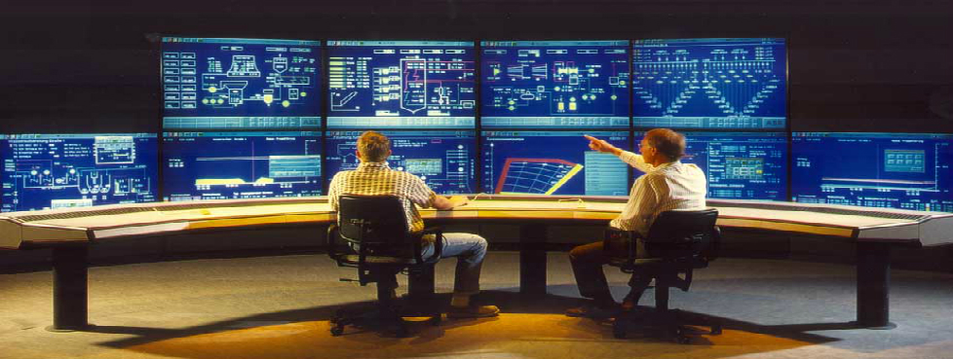
Thing 2: Instrumentation
New!

Slide 8

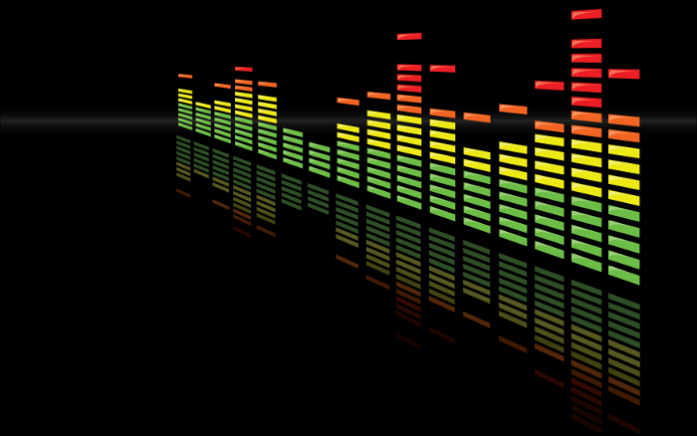

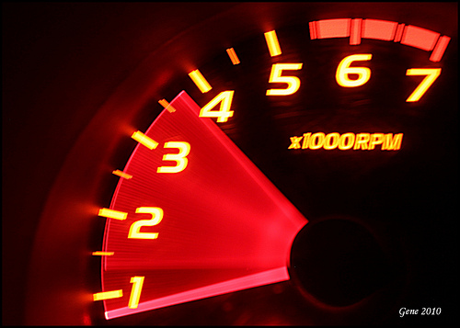

Thing 2: Instrumentation
New!
What to capture?
Counters – Incrementing or Decrementing counts
Gauges – Instantaneous Values
Meters – Rates of events
Histograms – Distribution of stream values
Timers – How long did a code block take to execute?

Slide 9
Thing 2: Instrumentation
New!
Visualise your metrics
Ask questions about your software.
Answer them visually.
Make them available.
DASHBOARD ALL THE THINGS!

Slide 10
Thing 2: Instrumentation
New!
Instrument EVERYTHING
Metrics.Net
Performance Counters
Frequency as well as Duration
Build Dashboards to surface metrics
Splunk

Slide 11
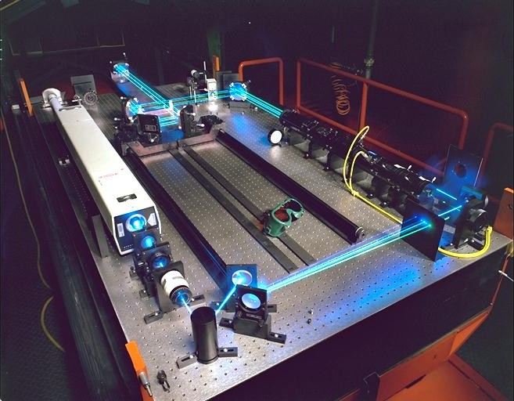
Thing 3: …
New!
Benchmark
Performance
Eh? What? Performance of what exactly?

Slide 12
Thing 3: Benchmark Performance
New!
What are your
Load-times ?
Chrome DevTools
BrowserPerf
PerfJankie
Part of your test suite

Slide 13
Thing 3: Benchmark Performance
New!
What are your
run-times?
BenchmarkDotNet
Part of your unit tests

Slide 14
Thing 3: Benchmark Performance
New!
Depends on instrumentation - usually
Performance baseline
Against representative data sets
Compare before and after changes
Tools: Benchmark.Net, Application Insights, SQL Profiler, PerfJankie

Slide 15
Thing 4: …
New!
Track your
Technical
Debt

Slide 16
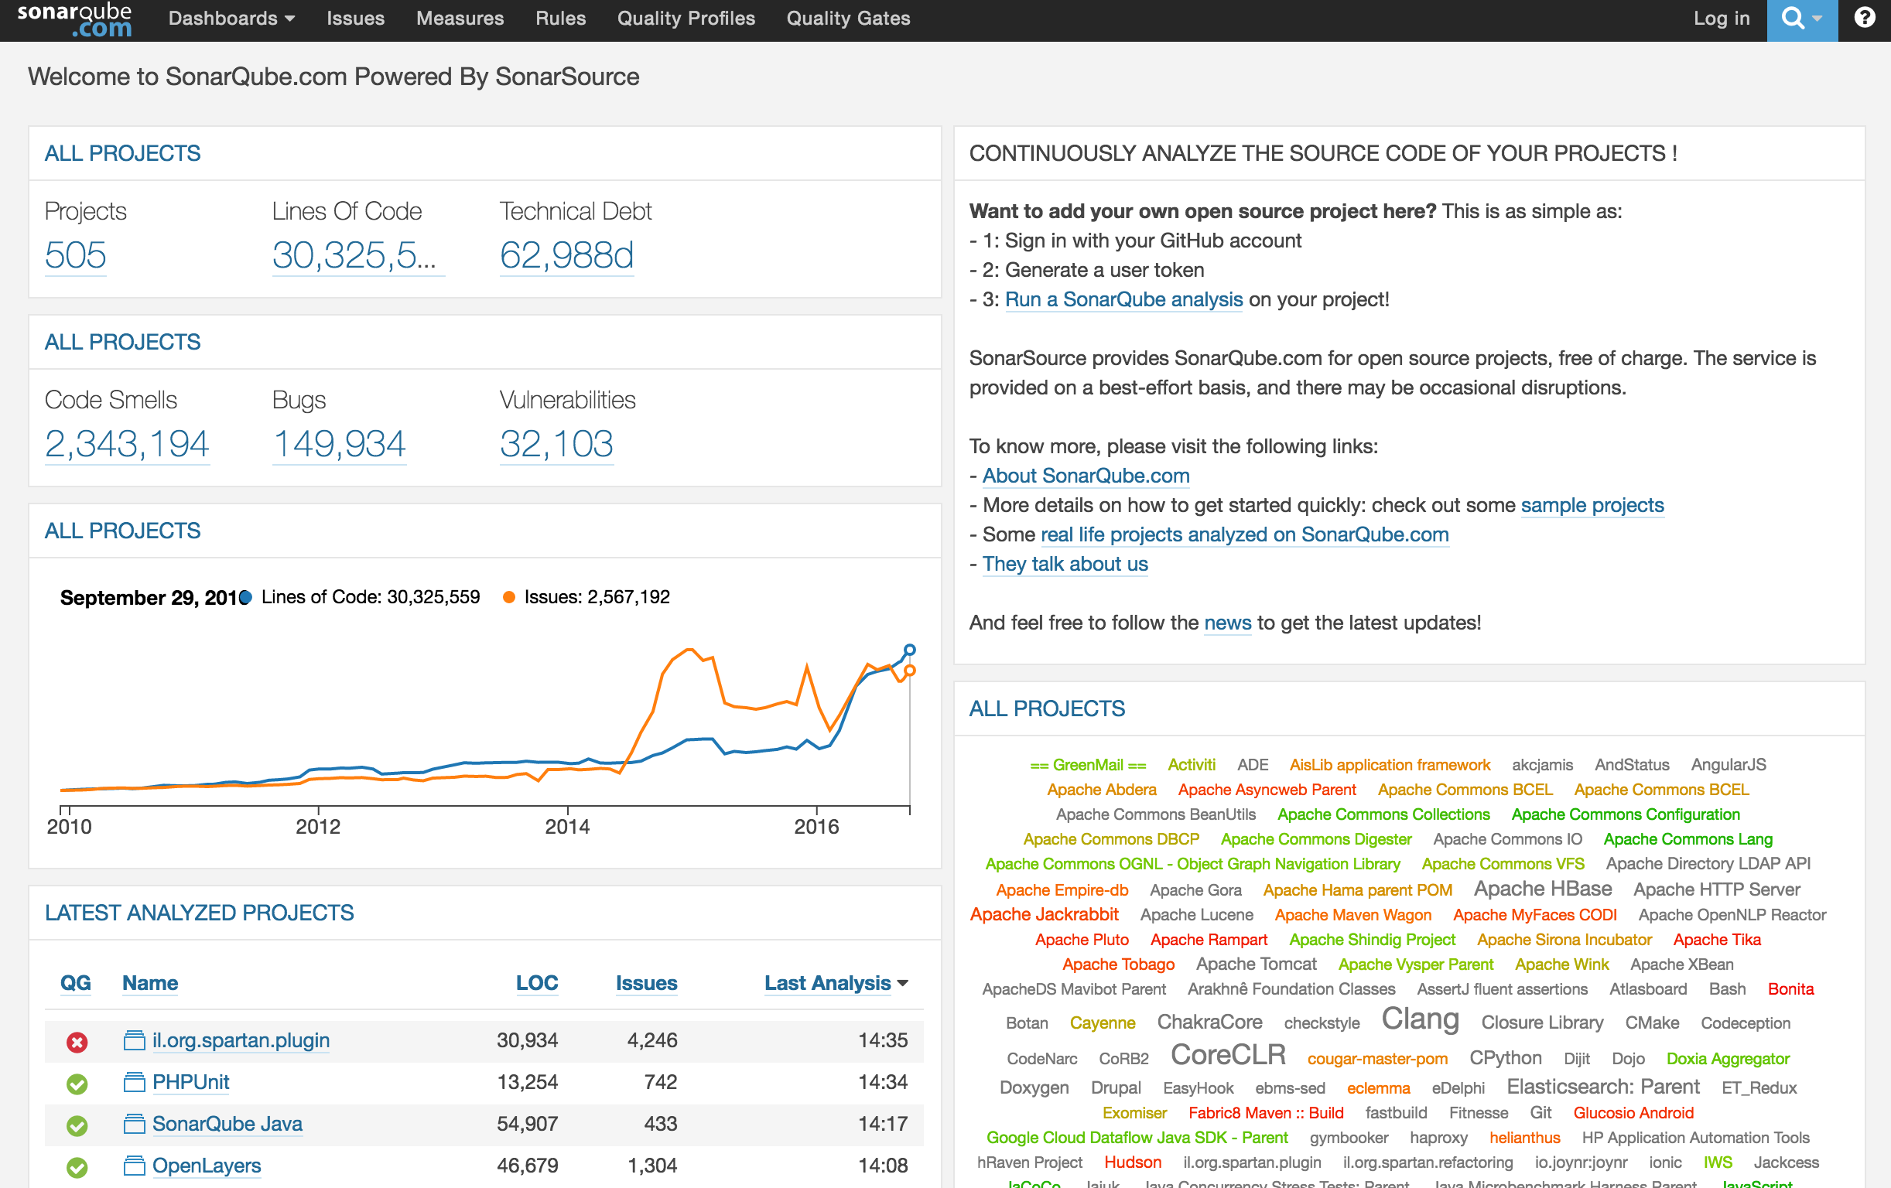
Thing 4: Track your Technical Debt
New!
SonarLint / SonarQube
Analyses source code
Records Results
Tracks changes
It’s a code quality dashboard!

Slide 17
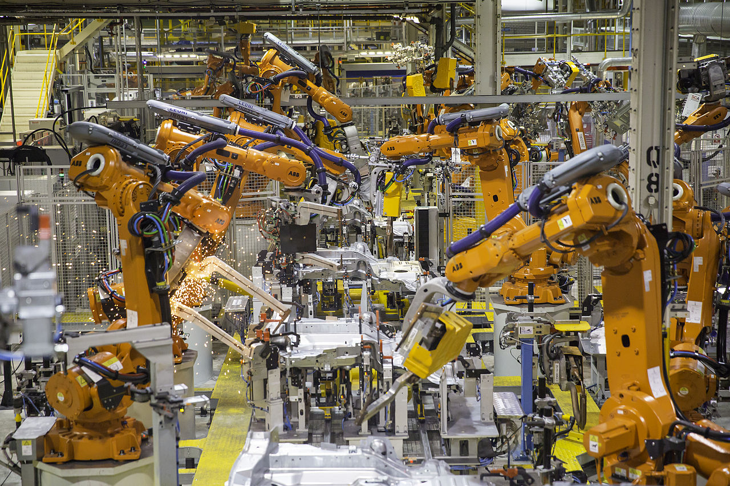
Thing 5: …
New!
Production
Readiness

Slide 18
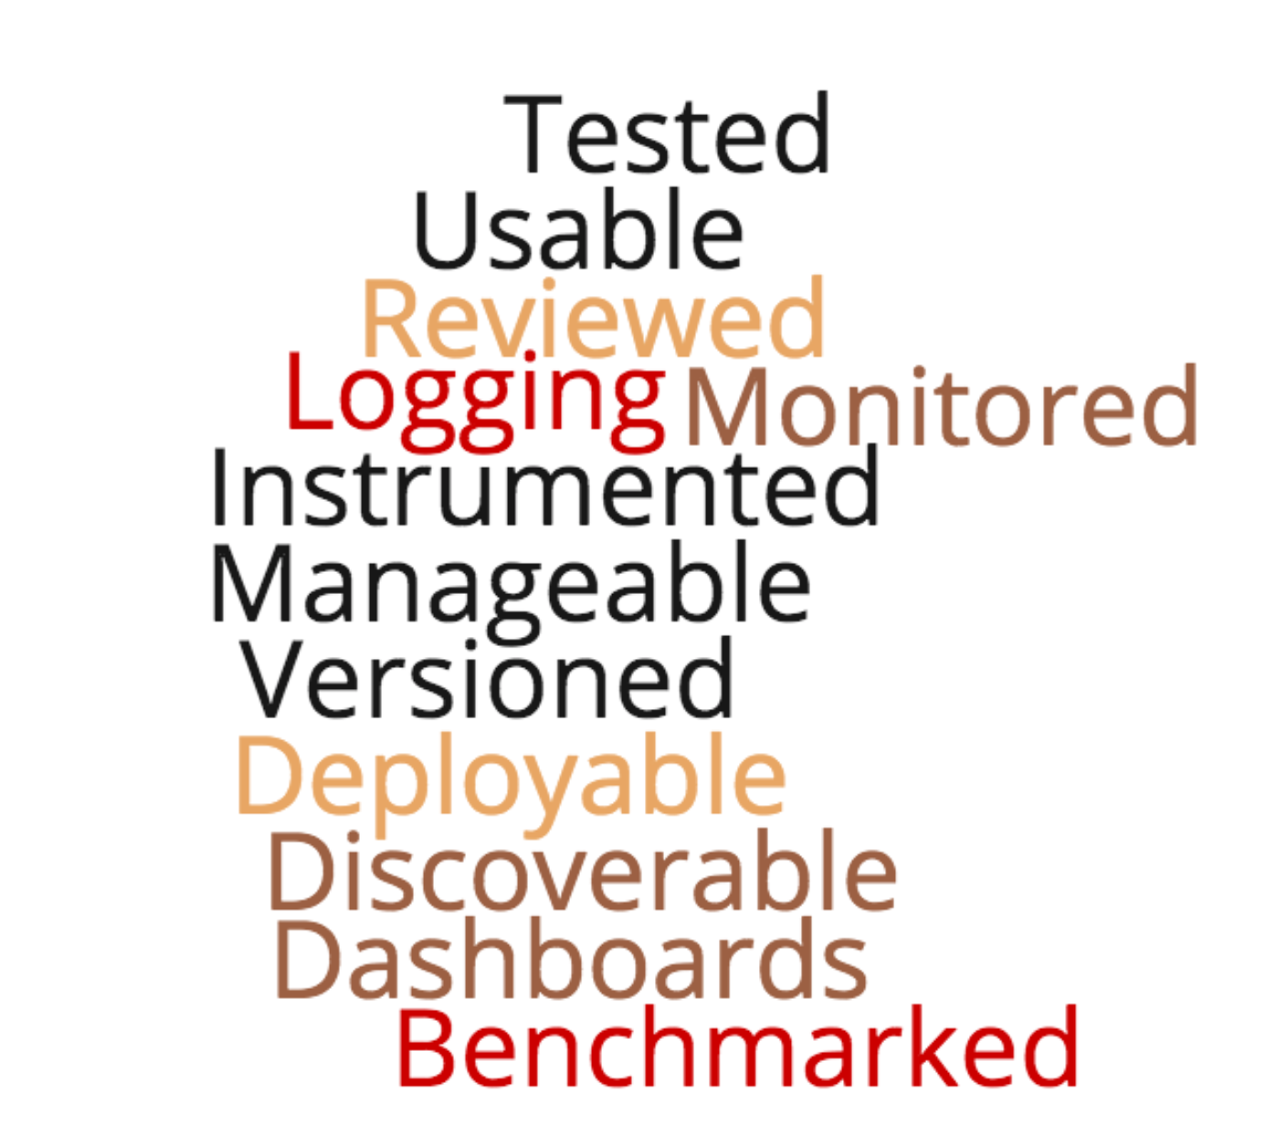
Thing 5: Production Readiness
New!
Are you Production Ready?
Is your software…
Don’t forget
all your lovely
NFRs!

Slide 19
Thing 6: …
New!
Step away from
the Shiny thing…

Slide 20
Thing 6: Step away from the Shiny thing…
New!
Restrain the urge to use the newest shiny stuff
New tools mean new problems
DO prototype or evaluate
But also be PRAGMATIC

Slide 21
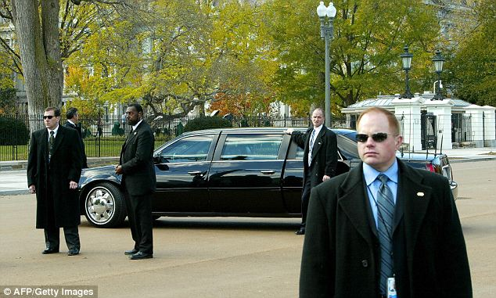
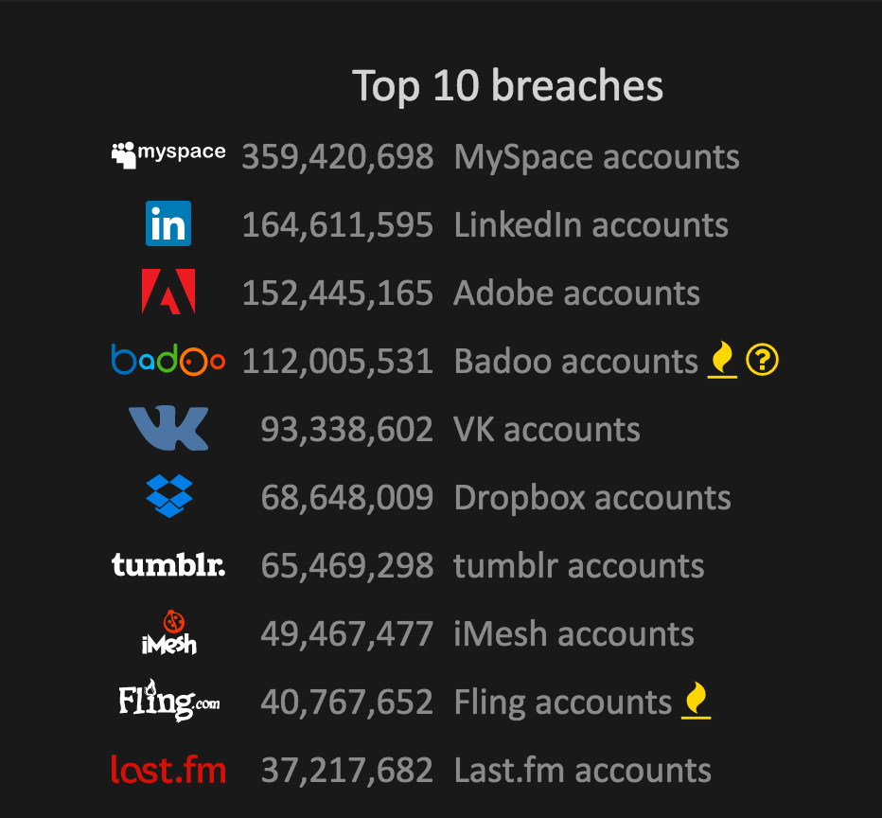
Thing 7: Security, Security, Security
New!

Slide 22
Thing 7: Security, Security, Security
New!
Build a security culture
Be objective
What are the attack vectors?
Where’s your data?
DON’T write it yourself
Crypto
AuthN
That one PEN test before deployment is NOT enough
Security is a Level zero feature
It’s NEVER optional

Slide 23
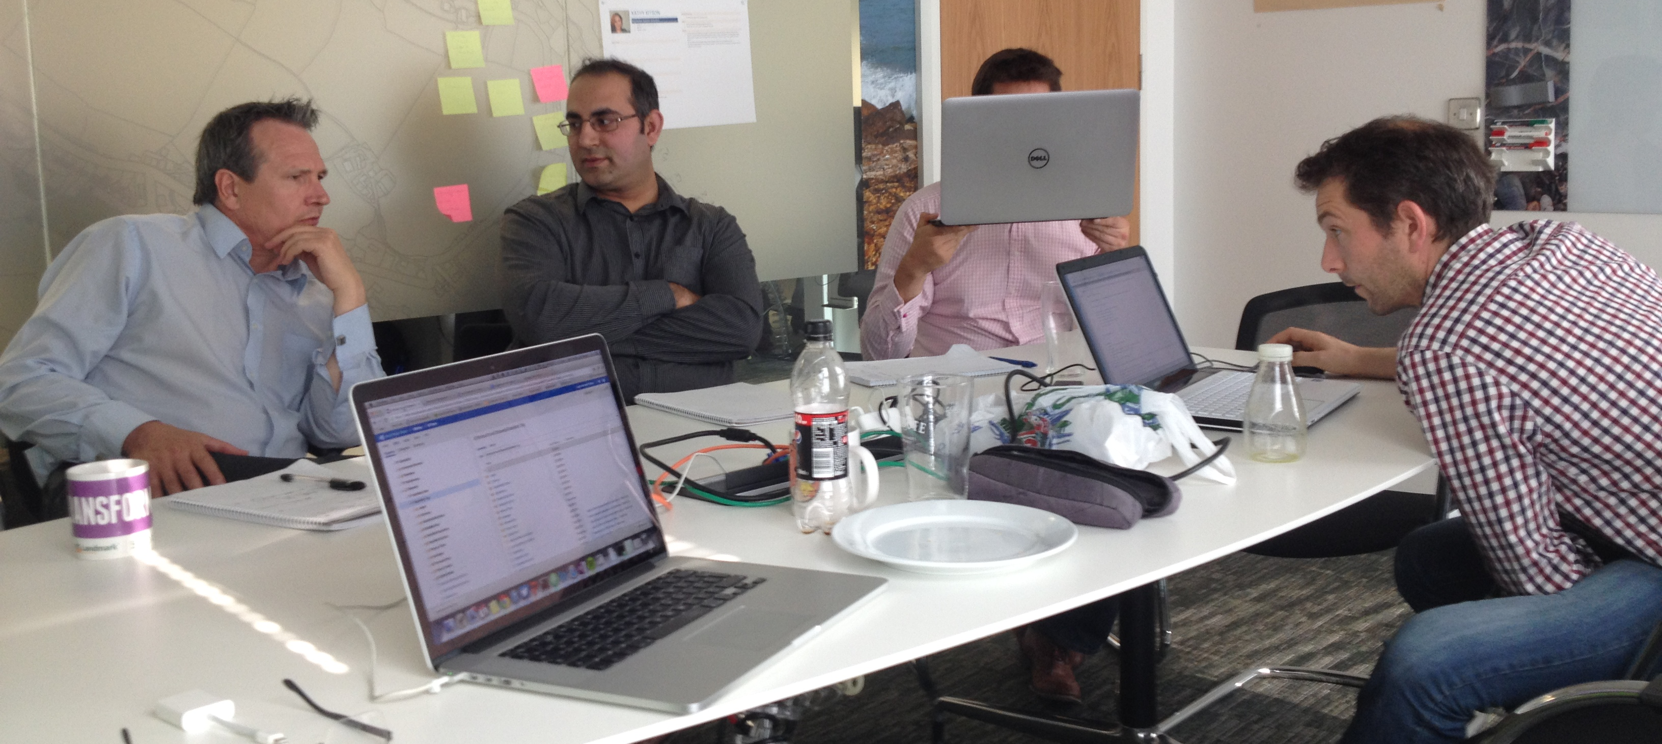
Thing 8: Clean Code Sessions
New!

Slide 24
Thing 8: Clean Code Sessions
New!
Unconference Style
Not just a moan-session
Everyone contributes
Invite Guests
Show’n’Tell SOMETHING each session

Slide 25

Thing 9: It’s all about the money…
New!
Do you know the
of that feature?
COST

Slide 26
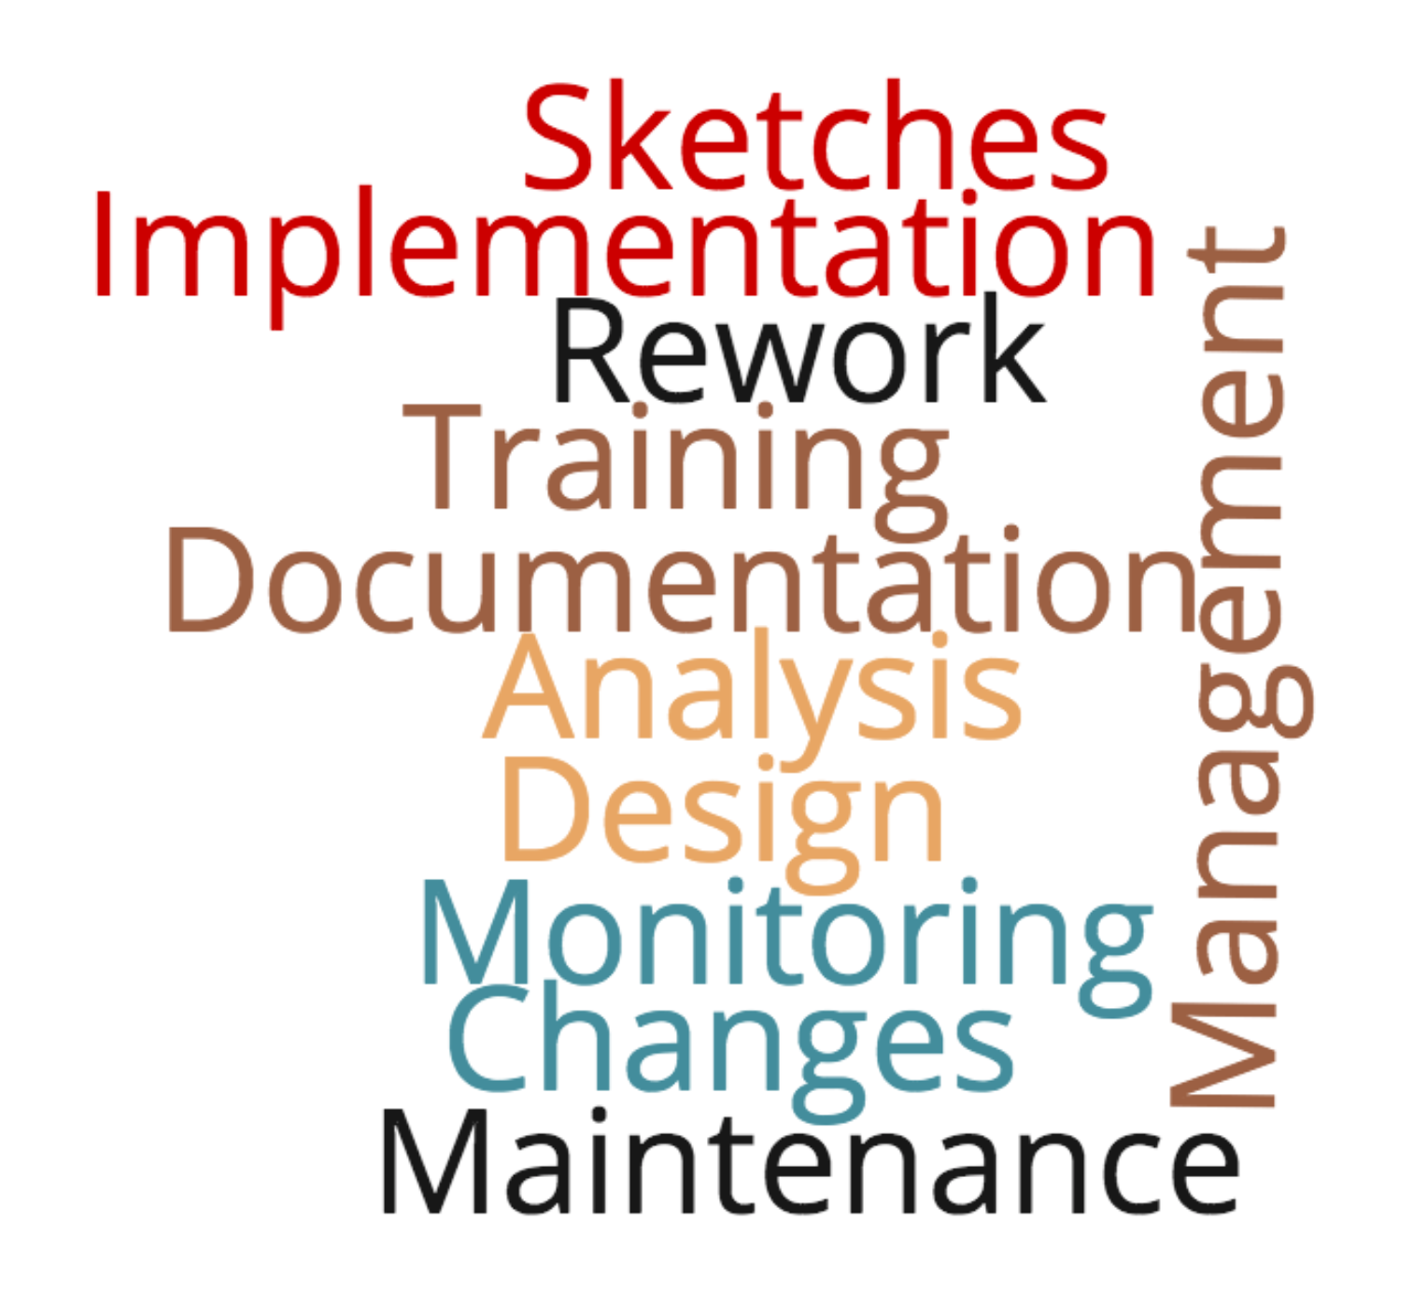
Thing 9: It’s all about the money…
New!
Consider what things actually cost…
”Yes, but let me work out the cost…”
Scaling up / out costs a lot
do you need to scale?

Slide 27

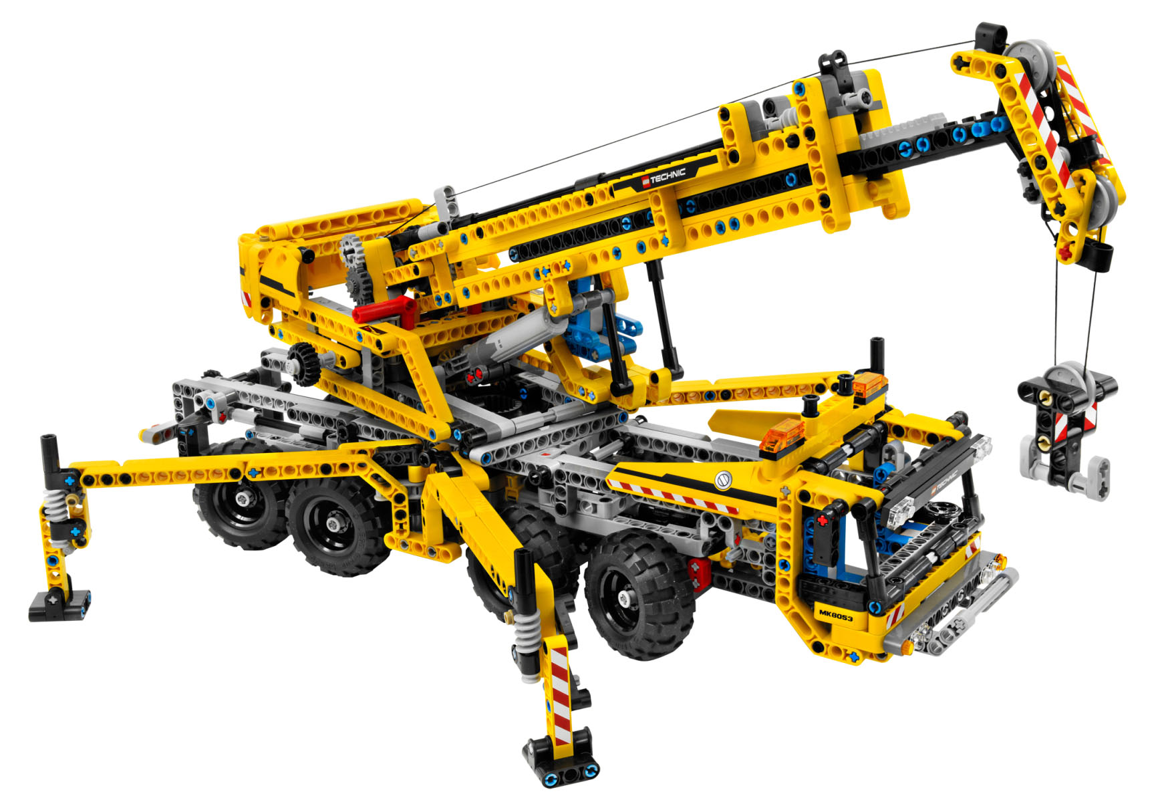
Thing 10: K.I.S.A.L.A.P
New!
Keep It Simple…
As Long As Possible.

Slide 28
Thing 10: K.I.S.A.L.A.P
New!
Balance YAGNI vs Product Capability
Cost of putting off complexity vs Technical Debt
Reworking a prototype for Production Readiness > Rewriting from scratch?
Don’t forget the end-game

Slide 29
In Summary
1 – Breakdown Requirements
2 – Instrument your Software
3 – Benchmark your Software
4 – Track your Technical Debt
5 – Ensure Production Ready
6 – Step away from the Shiny
7 – Security is never optional
8 – Have Clean Code sessions
9 – Translate work into money
10 – Keep It Simple… As Long As Possible

Slide 30
Thing 11: Remember…
Old!
Bad Ass!

Slide 31
?
Questions?

Slide 32
10 more things
Joel Hammond-Turner
@Rammesses
You need to do to succeed as a Tech lead

Slide 33
Sponsors
Notes:
Can’t emphasise enough how much they make it happen.
Platinum Sponsors:
University of Leeds – Venue & support.
DevExpress – Teas & Coffees.
Black Marble – organisation, design etc.
Sage – speaker shirts & general platinum sponsor.
Sonoco Trident – general platinum sponsor.
NDC – general platinum - visit their stand!
Equal Experts – pre-DDD North dinner (speakers, helpers & friends)
Silver Sponsors
X-lab
Github
Bronze Sponsors
JetBrains – licenses!
O’Reilly – vouchers!
Huddle – agendas ☺
Microsoft Press – books & vouchers!

